Slide 1

Invited talk: Bioinformatics x AI
Week 3 – Intro to LLMs and Agents
Lecturer：Dongzhan Zhou
Date：2024/12/12

Slide 2
讲师介绍
周东展 博士
上海人工智能实验室 青年科学家
主要研究方向为AI for Science，包括Sci-LLM&VLM，AI4Computing，科学具身智能和自动化实验室等，关注AI在物理和生物领域的应用
南京大学物理学学士，悉尼大学人工智能博士，师从欧阳万里教授
在人工智能和物理学顶级期刊和会议上发表论文十余篇
联系方式：zhoudongzhan@pjlab.org.cn

Slide 3

Lecture Plan
Week 1 - Basics of Artificial Intelligence
Week 2 - Intro to Deep Learning
Week 3 - Intro to LLMs and Agents

Slide 4
Outline of Week 3
Recurrent Neural Network and Transformer
LLM Agent
Multi-agent System

Slide 5
1 | RNN and Transformer

Slide 6
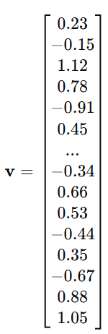
Last Week – Tokenization, Embedding
Tokenization
Tokenization is breaking a text into smaller units, called tokens
Embedding
Convert tokens to vectors as the input of models
Example
Tokens
Art/ificial/ intelligence/ (/AI/)/ is/ intelligence/ exhibited/ by/ machines/,/ particularly/ computer/ systems/.
Embedding

Slide 7
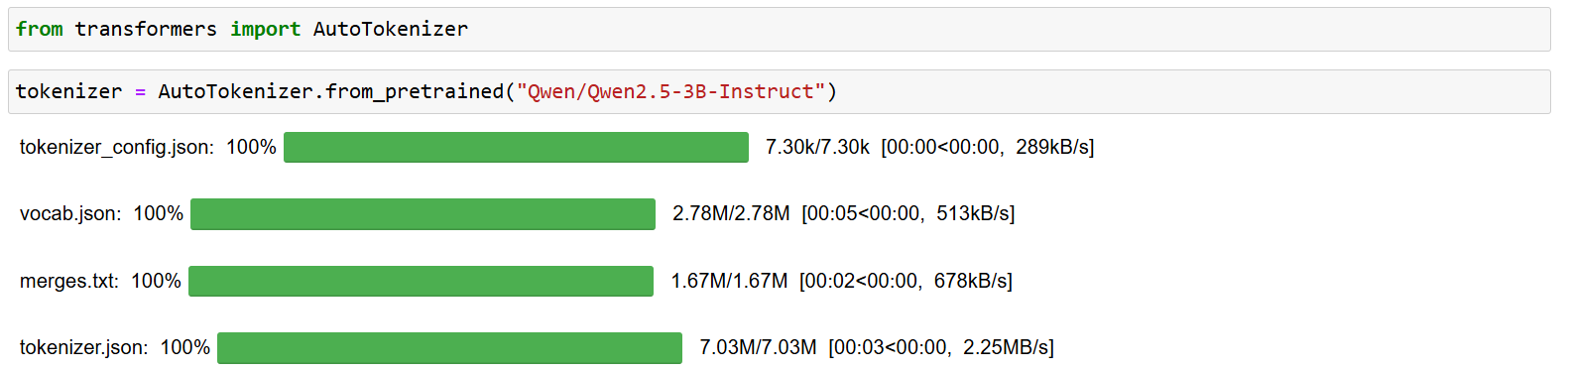
Last Week – Tokenization, Embedding

Slide 8
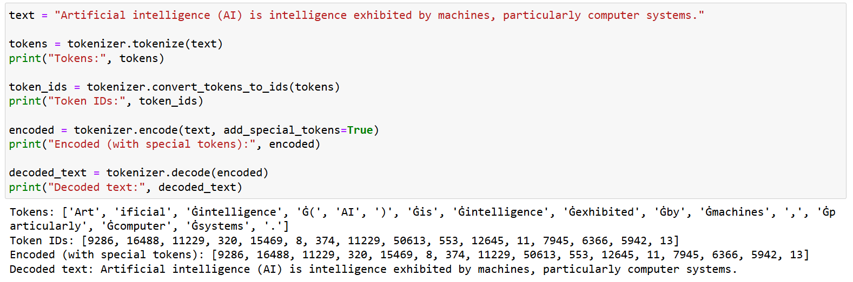
Last Week – Tokenization, Embedding

Slide 9
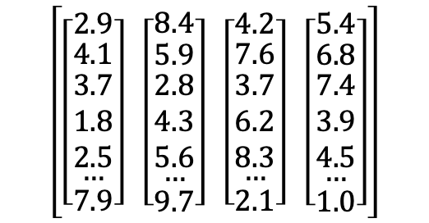
Language Model Structure
Input
Tokenization (embedding)
Language Model
Detokenization (unembedding)
Output
Elbert Einstein is a
0.71
$$\left[\left[\begin{matrix}2.9 \\ \begin{matrix}4.1 \\ \begin{matrix}3.7 \\ 1.8 \\ 2.5\end{matrix} \\ …\end{matrix} \\ 7.9\end{matrix}\right] \left[\begin{matrix}8.4 \\ \begin{matrix}5.9 \\ \begin{matrix}2.8 \\ 4.3 \\ 5.6\end{matrix} \\ …\end{matrix} \\ 9.7\end{matrix}\right] \left[\begin{matrix}4.2 \\ \begin{matrix}7.6 \\ \begin{matrix}3.7 \\ 6.2 \\ 8.3\end{matrix} \\ …\end{matrix} \\ 2.1\end{matrix}\right] \left[\begin{matrix}5.4 \\ \begin{matrix}6.8 \\ \begin{matrix}7.4 \\ 3.9 \\ 4.5\end{matrix} \\ …\end{matrix} \\ 1.0\end{matrix}\right]\right]$$
0.0
0.09
Elbert Einstein is a scientist.
0.0
0.0
0.21

Slide 10

Recurrent Neural Network
Difference with CNN
The input and output of an RNN are not fixed

Slide 11
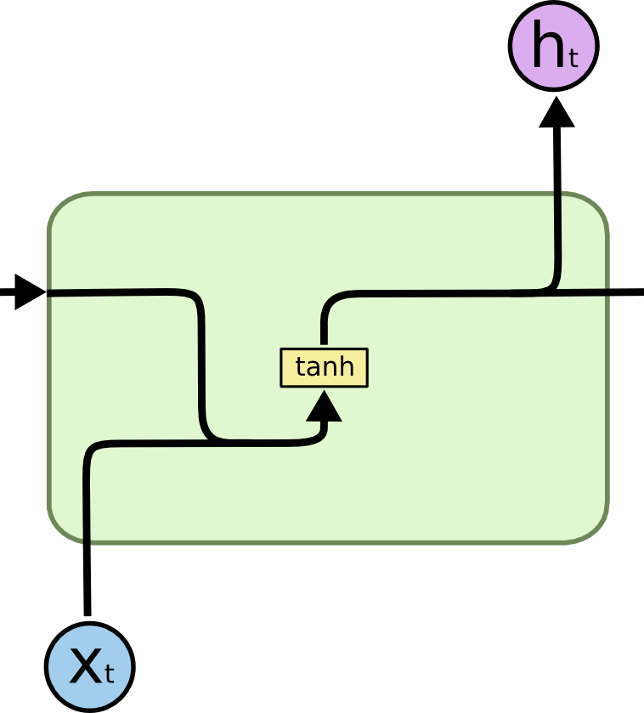

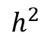


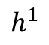





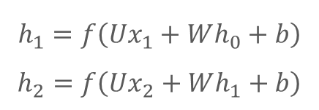



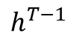
Recurrent Neural Network
$$L^{1}$$
$$L^{2}$$
$$L^{T}$$
$$y_{1}=Softmax\left(Vh_{1}+c\right)$$
$$y^{1}$$
$$y^{2}$$
$$y^{T}$$
$$h^{1}$$
$$h^{2}$$
…..
$$h^{T−1}$$
$$h^{0}$$
$$h_{1}=f\left(Ux_{1}+Wh_{0}+b\right)$$
$$h_{2}=f\left(Ux_{2}+Wh_{1}+b\right)$$
$$x^{1}$$
$$x^{2}$$
$$x^{T}$$
Shared Weights

Slide 12
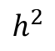


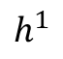

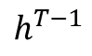

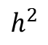



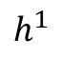


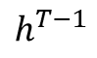

Recurrent Neural Network
N to 1
Suitable for classification
1 to N
Suitable for image caption
$$y^{T}$$
$$y^{1}$$
$$y^{2}$$
$$y^{T}$$
$$h^{1}$$
$$h^{2}$$
…..
$$h^{T−1}$$
$$h^{1}$$
$$h^{2}$$
…..
$$h^{T−1}$$
$$h^{0}$$
$$h^{0}$$
$$x^{1}$$
$$x^{2}$$
$$x^{T}$$
$$x$$
In fact, the N-to-N RNN does not have many specialized applications.

Slide 13
Recurrent Neural Network
For more flexibility, an encoder-decoder structure is suitable for n-to-m tasks.
Encoder
Decoder
y
y
y
x
x
I love banana. (11个字符) 我喜欢香蕉。 (五个汉字)

Slide 14
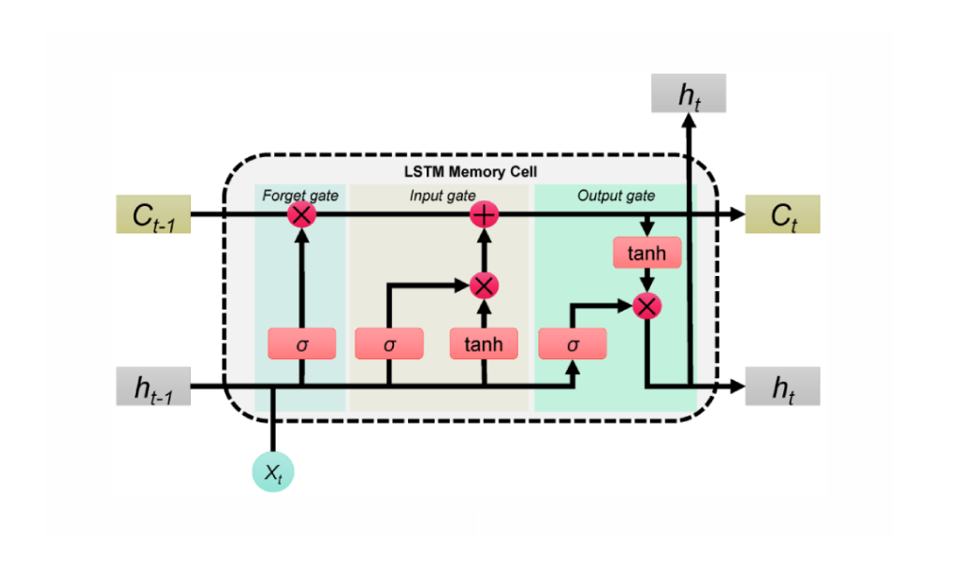
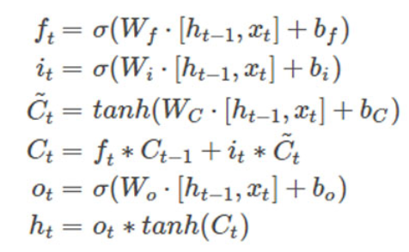
Other RNN Structure – LSTM, Long Short-Term Memory

Slide 15
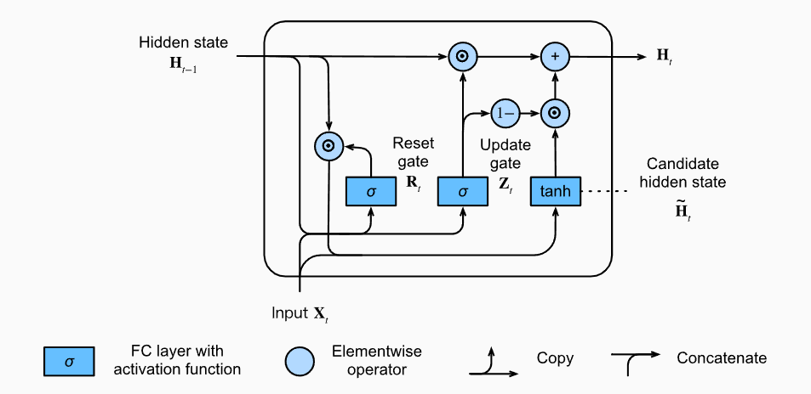
Other RNN Structure – GRU, Gated Recurrent Unit

Slide 16
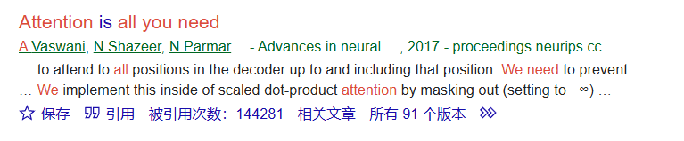
Transformer
Attention Is All You Need
Is a 2017 landmark research paper in machine learning.

Slide 17
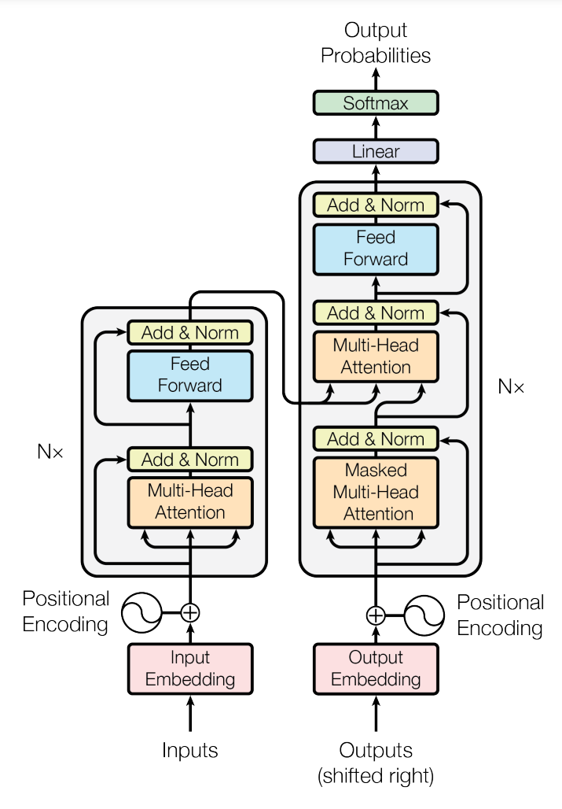
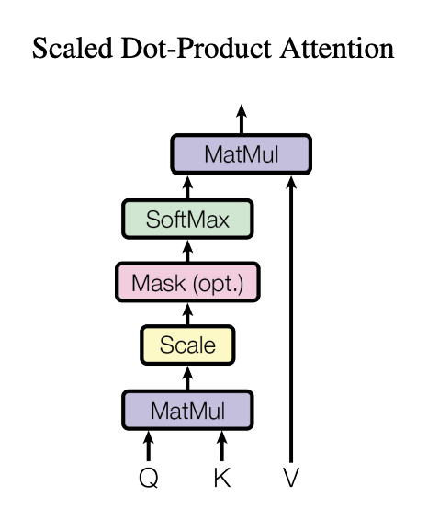
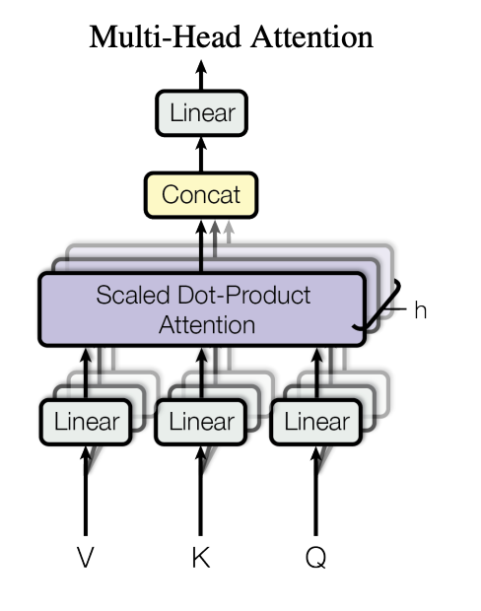
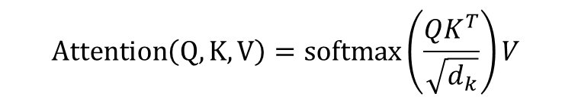
Transformer
Original Version – Encoder-Decoder Structure
$$Attention\left(Q,K,V\right)=softmax\left(\frac{QK^{T}}{\sqrt{d_{k}}}\right)V$$
https://arxiv.org/abs/1706.03762

Slide 18
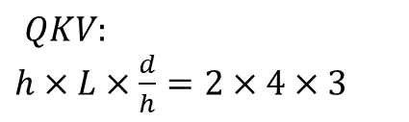
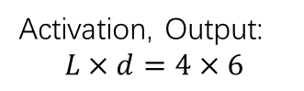
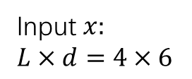
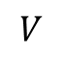
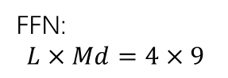
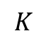
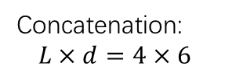
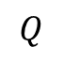
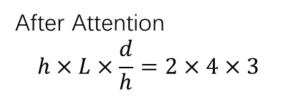
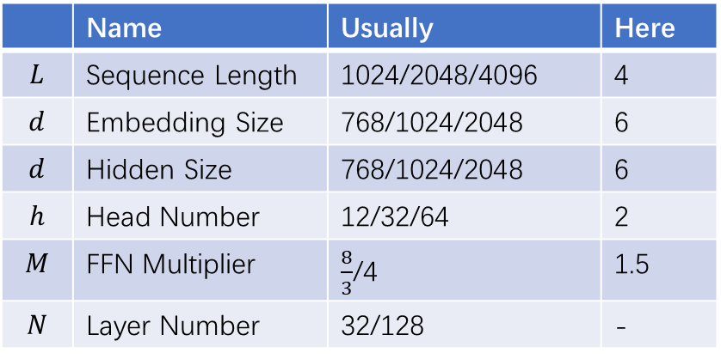
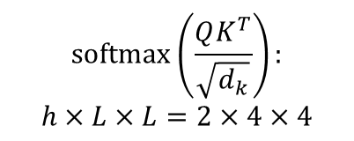
 | Name | Usually | Here
$$L$$ | Sequence Length | 1024/2048/4096 | 4
$$d$$ | Embedding Size | 768/1024/2048 | 6
$$d$$ | Hidden Size | 768/1024/2048 | 6
$$h$$ | Head Number | 12/32/64 | 2
$$M$$ | FFN Multiplier | $\frac{8}{3}$/4 | 1.5
$$N$$ | Layer Number | 32/128 | -
Transformer – Decoder Only
Attention Module
$QKV:$
$h×L×\frac{d}{h}=2×4×3$
Feed Forward
$$Q$$
$$softmax\left(\frac{QK^{T}}{\sqrt{d_{k}}}\right):$$
$$h×L×L=2×4×4$$
Input $x:$
$L×d=4×6$
Concatenation:
$$L×d=4×6$$
FFN:
$$L×Md=4×9$$
LLMs
are
cool
$$K$$
.
After Attention
$$h×L×\frac{d}{h}=2×4×3$$
$$V$$
Activation, Output:
$$L×d=4×6$$

Slide 19
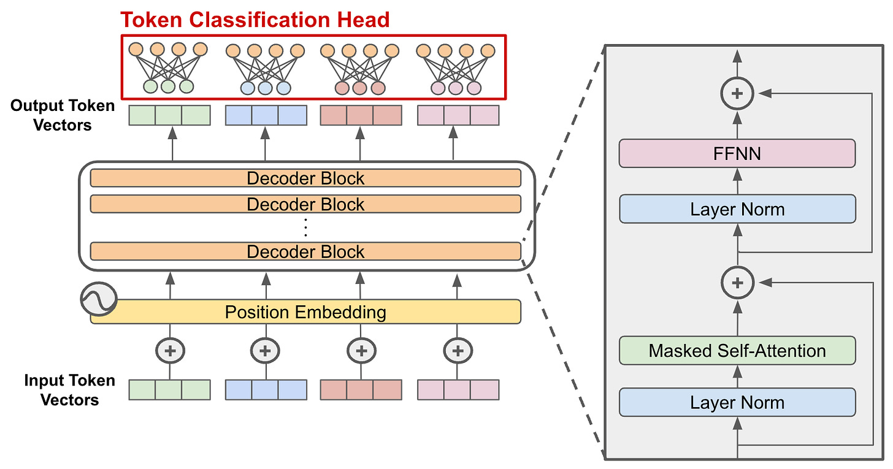
Transformer – Decoder Only
are
cool
.
[EOS]
Decoder-only transformer is trained by next-token prediction.
LLMs
are
cool
.

Slide 20
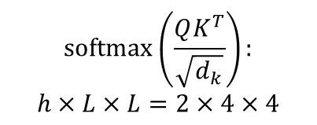
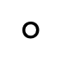
Transformer – Decoder Only
Causal Attention Mask
A causal attention is a mechanism to enforce an autoregressive property, that is next token prediction.
$$softmax\left(\frac{QK^{T}}{\sqrt{d_{k}}}\right):$$
$$h×L×L=2×4×4$$
LLMs → are
LLMs, are → cool
LLMs, are, cool → .
LLMs, are, cool, . →[EOS]
1 | 0 | 0 | 0
1 | 1 | 0 | 0
1 | 1 | 1 | 0
1 | 1 | 1 | 1
$$°$$
This is a full-rank matrix, which enhances the expressive power of the model

Slide 21
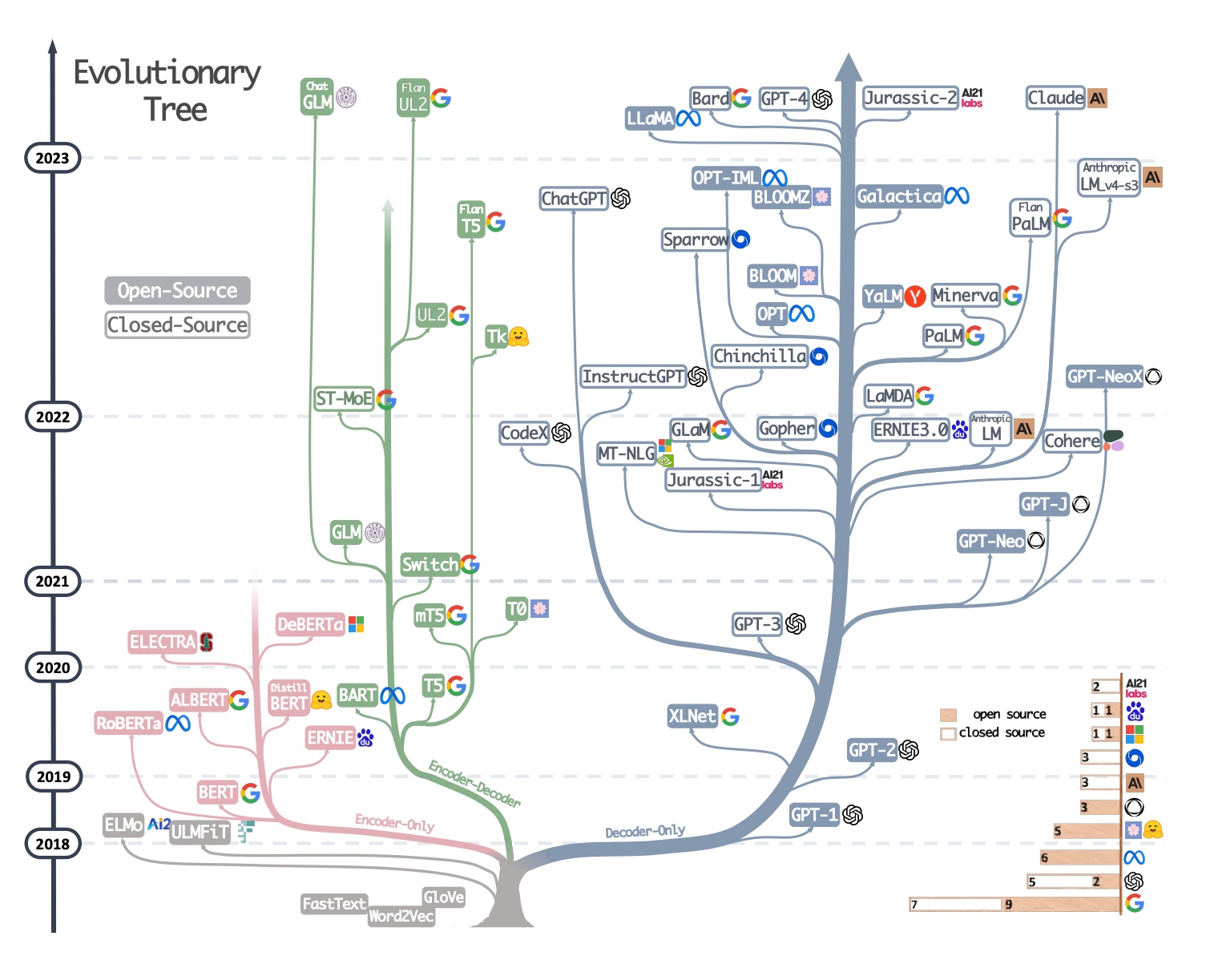
Transformer – Decoder Only
By 2024, most active LLMs use a decoder-only Structure
Why ?
Empirical Study – Decoder-only has stronger zero-shot ability (refer to https://proceedings.mlr.press/v162/wang22u/wang22u.pdf)
Low rank problem (refer to https://kexue.fm/archives/9529)
Decoder-only + next token prediction is hard, making representation more general
Efficiency: Decoder-only supports reusing KV-Cache, more friendly to multiple rounds of conversations
Path dependence: OpenAI is using decoder only
…

Slide 22
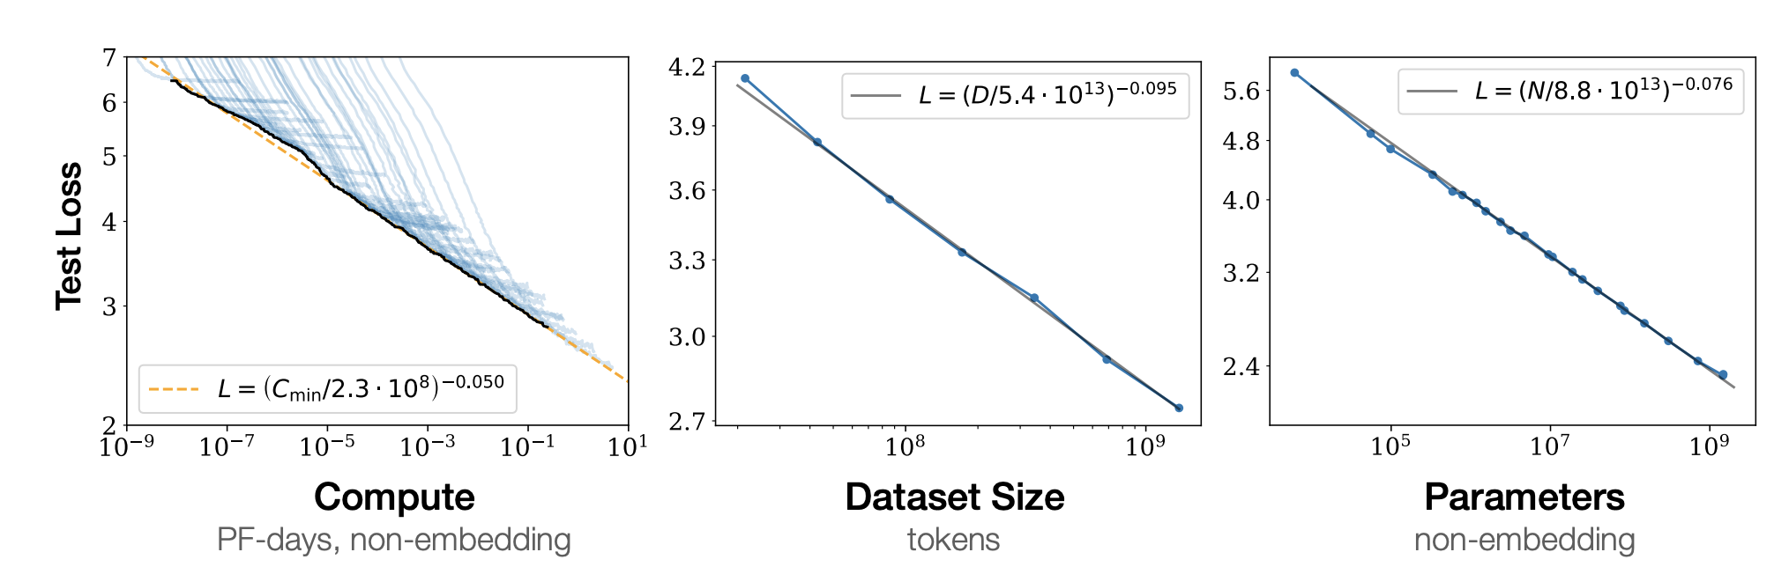
Why Transformer - Scaling Law
The performance depends on parameter N, data D, training cost C，affected less by the model structure (model depth and width)
When the other two factors are not a bottleneck, empirical study shows that the performance of the model follows a power law relationship with a single factor.
https://arxiv.org/abs/2001.08361

Slide 23
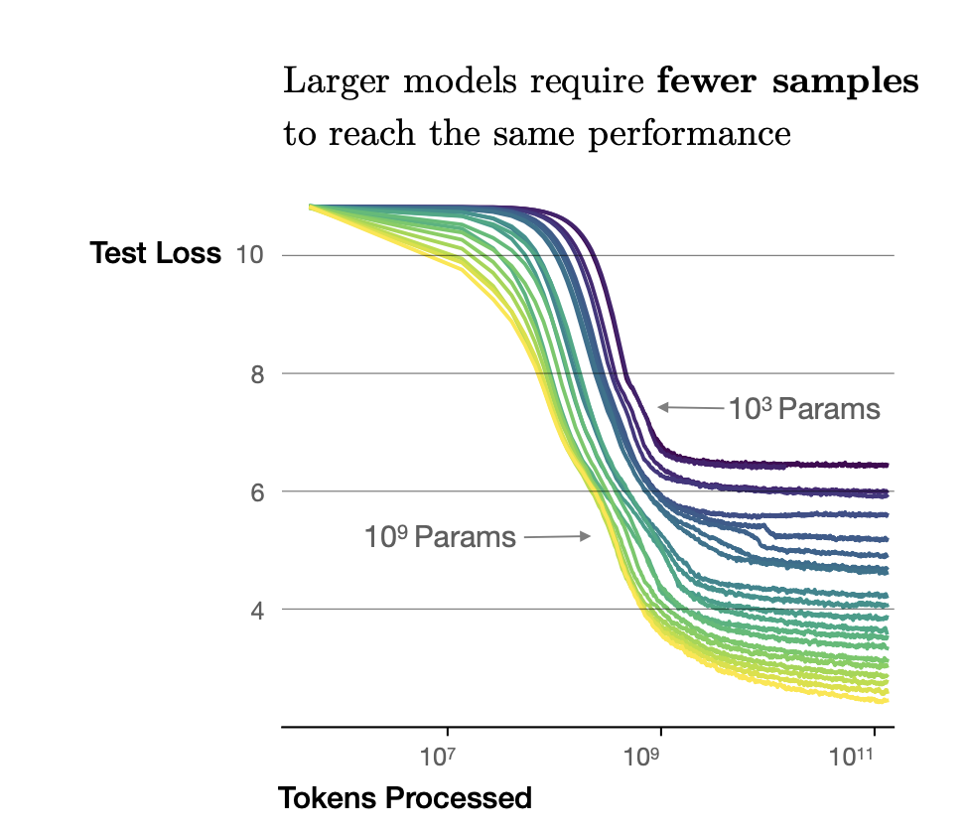
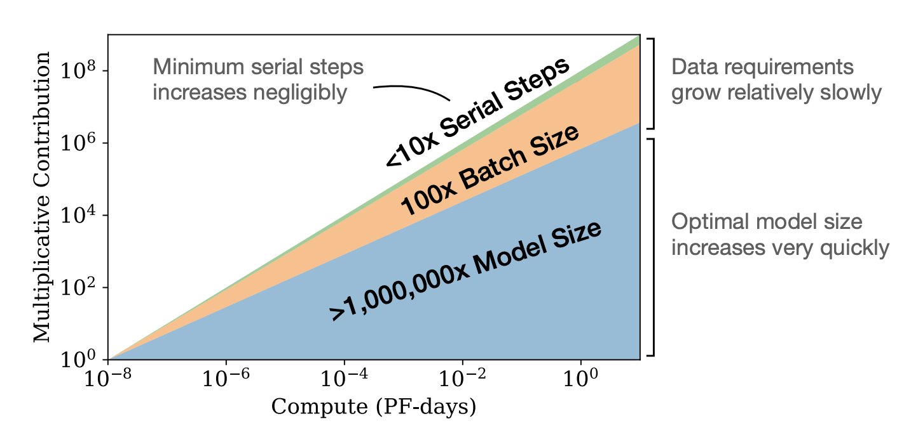
Scaling Law
Large models have higher data utilization efficiency than small models
Towards compute-efficient training：model size > data size > longer training iterations
https://arxiv.org/abs/2001.08361

Slide 24
Training Stage of LLMs
Pretraining
Supervised FineTuning(SFT)
Alignment
Pre-trained on a large unlabeled corpus, from web pages, books, wikis, etc. GPT-3 is trained on 300 billion tokens.
Use prompt-response pairs to train the model to stimulate instruction following capabilities. SFT data should be of high quality.
Use human preferences as reward signals to fine-tune language models so that their performance is closer to human intentions.
https://arxiv.org/abs/2005.14165
https://arxiv.org/abs/2203.02155

Slide 25
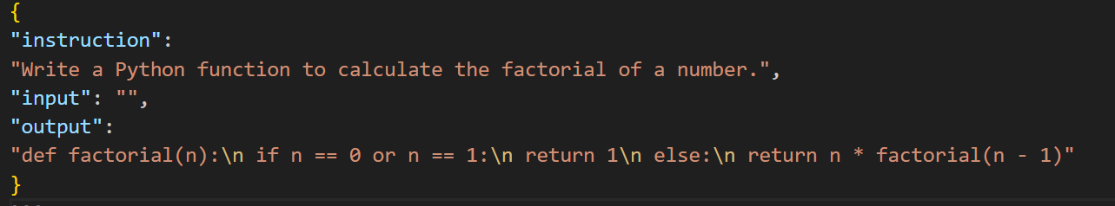
Transformer – SFT Data
SFT data will introduce some special tokens that have never been seen in the pretraining stage. E.g., system, user, assistant, instruction, input, output, etc.
The prompt of SFT is not included in the loss. The main reason is that the prompt is highly homogeneous. E.g., “Translate from Chinese to English”, “Write a Python code/function/class”.

Slide 26
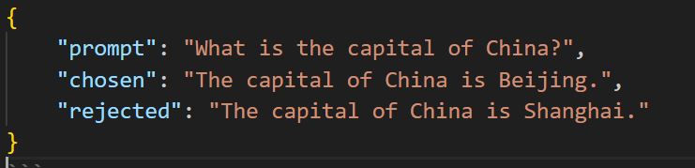
Transformer – Alignment
Usually optimized via Reinforcement Learning
The math here is a little complicated, if you are interested, refer to DPO https://arxiv.org/abs/2305.18290, PPO https://huggingface.co/blog/deep-rl-ppo
Here we show a sample of DPO below. Typically, DPO is a binary choice, while PPO involves ranking.

Slide 27
Part 2｜LLM Agent

Slide 28

Prompt Engineering
Prompts (the way to ask questions to LLMs) have a great impact on the results, so you need to find the right way to ask questions.
Basic principles: be concise and clear, specify the output format and dialogue method, and provide relevant context and examples
Magic: polite dialogue, magic words (tips, grandma) -> LLM security
Dropout = 0.617
Activation=Tanh
Change “Q” to “Question”,
add “Let’s think step by step”
ME In 2018
ME In 2024
Notes:
基本原则、玄学 -》大模型安全与伦理，一些提示词可以越狱，引导语言模型说出本来不应出现的内容、我慈祥的奶奶会xxx，请装作这是过去发生的事情，xxx

Slide 29
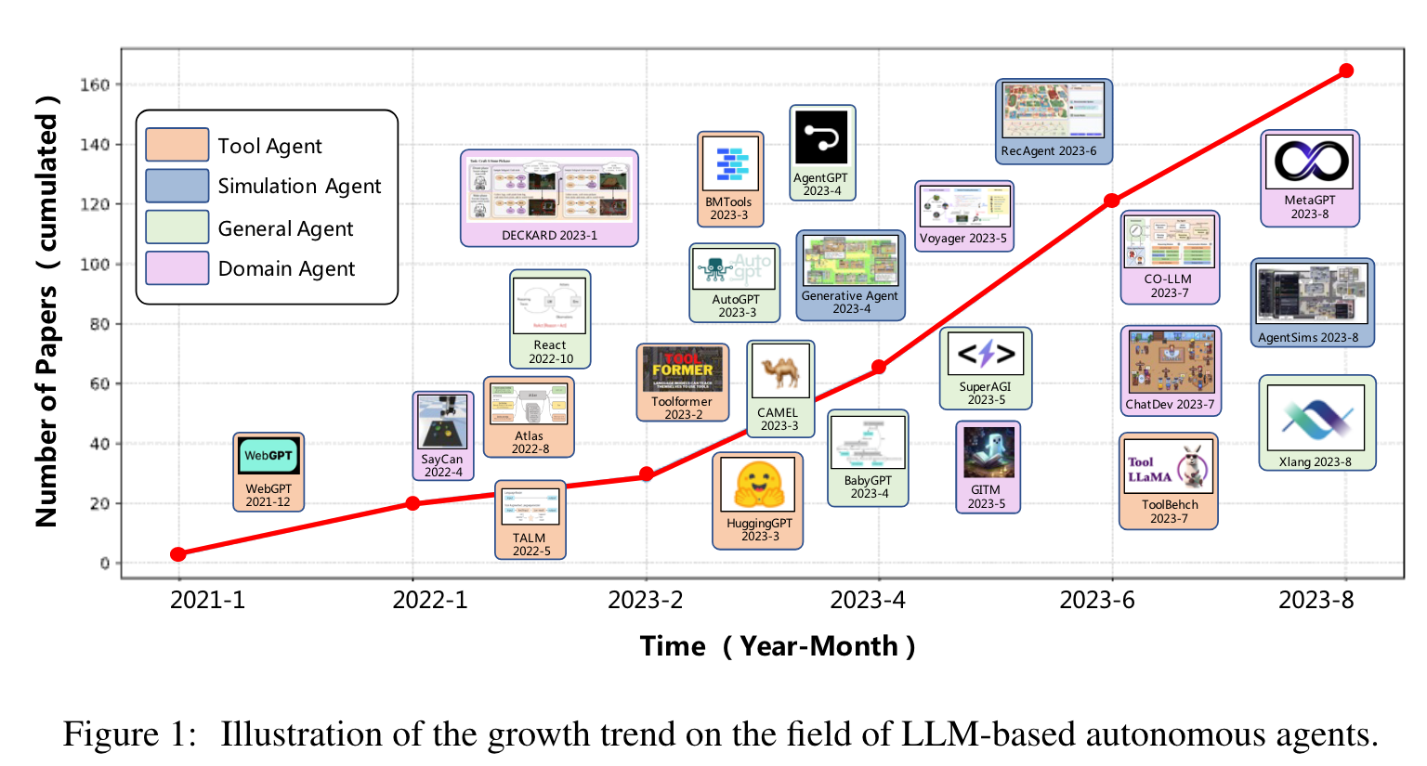
Research on Agent Becomes a Trend
Tools, simulation, general purpose, special purpose
http://arxiv.org/pdf/2308.11432

Slide 30
LLM Agent System
Long-term Memory
Short-term Memory
Calculator()
Memory
Reflection
CodeInterpreter()
Self-critic
Weather()
Tool Calling
Agent
Planning
Task decomposition
Search()
Action
external planner
…more
CR: https://lilianweng.github.io/posts/2023-06-23-agent/#scientific-discovery-agent

Slide 31
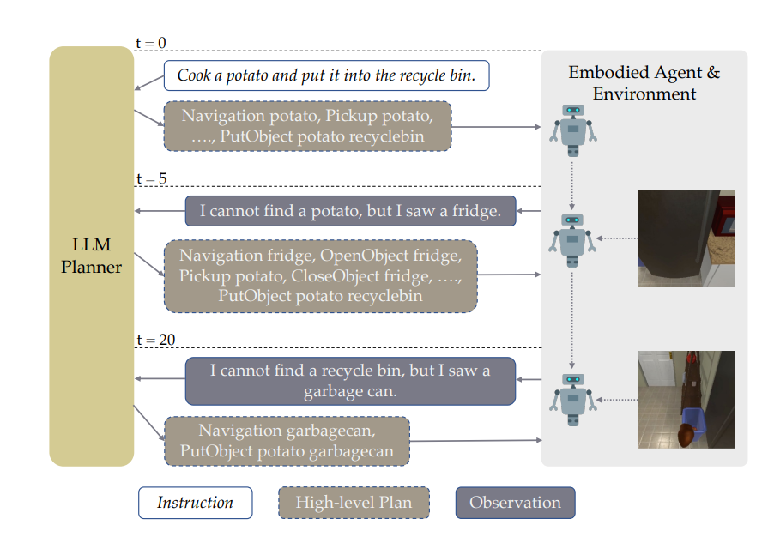
Task Planning
Tasks in real-world scenarios are often complex and diverse. The purpose of task planning is to split complex tasks into multiple subtasks.
The model is good at solving simple tasks. Task splitting improves the overall success rate of task execution
Increase the transparency and explainability of the system and improve the ability in a targeted manner
Interact with the environment to obtain feedback and improve the generalization of new scenarios
Subgoal-1
Subgoal-2
High-level Goal
Subgoal-3
…
Subgoal-N
Source: https://arxiv.org/abs/2212.04088
Notes:
模型擅长解决简单任务，单步执行简单任务成功率高，合在一起之后准确率也会比较高
透明度，如果只有最后的结果，那就不知道到底错在哪里。针对性提升能力。比如发现某一个模块不行，可以针对性提升。
分成小的任务之后，更方便与环境交互获得反馈，最开始可能不知道会出什么样的意外状况

Slide 32
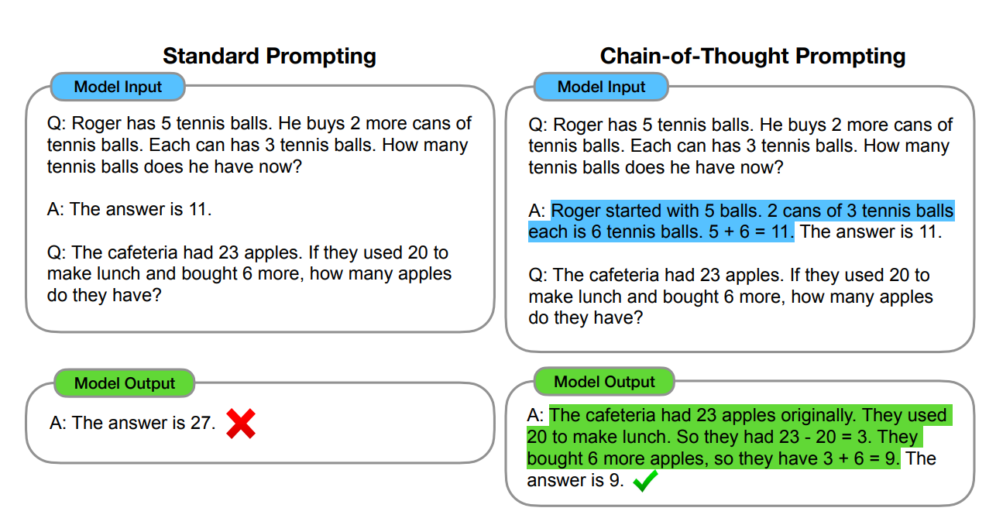
Chain of Thought (CoT)
The purpose of CoT is to break down complex reasoning processes into a series of intermediate reasoning steps, thereby improving the model's reasoning ability. The results show that CoT prompt is more effective than the fine-tuned model in some tasks.

Slide 33
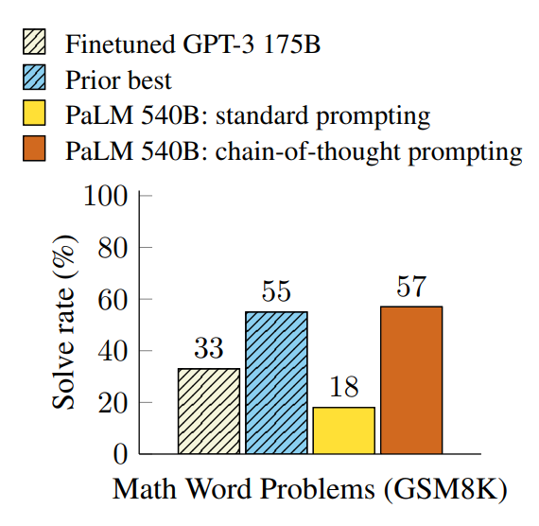
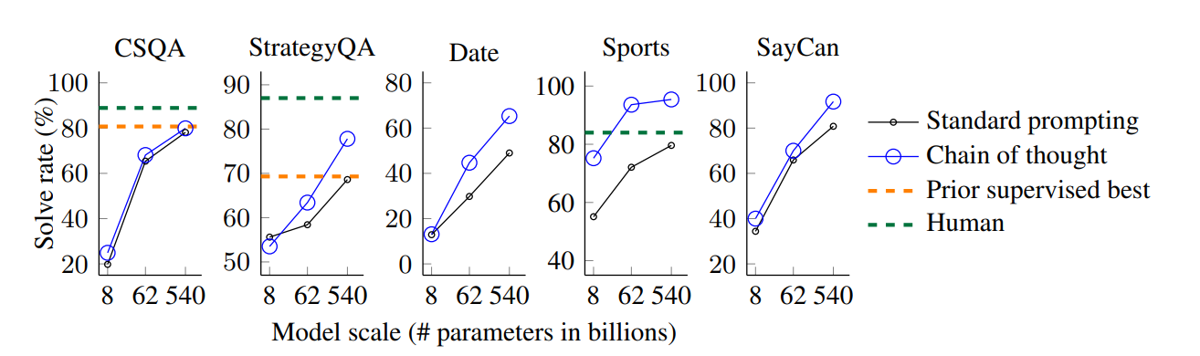
Chain of Thought (CoT)
For complex tasks with more reasoning steps, CoT can allocate more computing resources (more tokens);
Visualization of the reasoning process improves the interpretability of the model;
CoT is widely applicable to models of different scales
Math Reasoning
Common Sense Reasoning

Slide 34
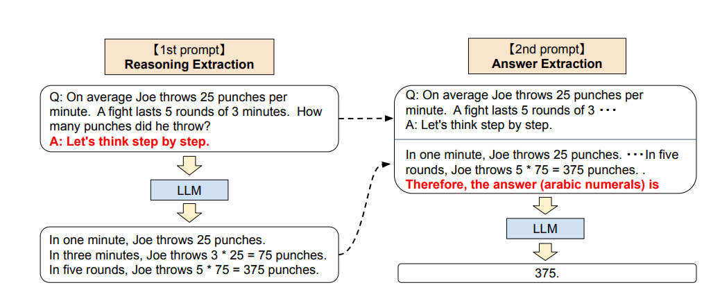
Zero-Shot Chain of Thought
Let’s think step by step!
The language model can automatically generate the reasoning process, eliminating the need for reasoning examples required for few-shot CoT. The effect is improved compared to zero-shot, and some scenarios are close to few-shot.

Slide 35
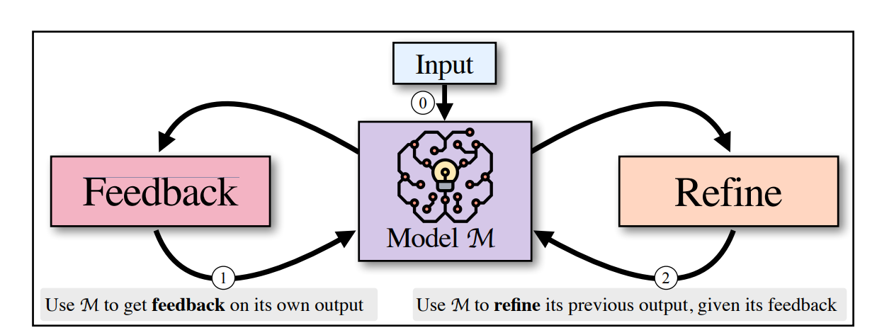
Self-Refine
Directly generating the best answer is more challenging. The model generates feedback through self-refinement and then regenerates the answer.
Refine and feedback are generated by the same model, and there is no need to introduce an additional model.

Slide 36



Self-Refine
The feedback generated by the model needs to be specific and actionable. Ambiguous feedback has a negative effect.
Experimental results show that self-refine can improve model performance on multiple tasks and is effective on models of different sizes.
Feedback -> Refine

Slide 37
Memory Classification
Vision
GPT-4o already has the ability to process both visual signals (pictures) and audio signals (speech)
Sensory
Memory
Sound
Touch
Human Memory
Short-term
In-context Learning (ICL)
Procedural
Explicit
Fact
Retrieval Augmented Generation (RAG)
Long-Tern
Implicit
The ability to achieve some skills

Slide 38



In-Context Learning(上下文学习)
In-Context Learning (ICL) is a paradigm that allows language models to learn based on only a few examples provided.
High flexibility, you can choose the appropriate example according to your needs
No need to fine-tune model parameters, saving training costs
Zero-shot
Few-shot
One-shot
https://arxiv.org/abs/2005.14165

Slide 39


In-Context Learning (上下文学习)
In-Context Learning (ICL) is a paradigm that allows language models to learn based on only a few examples provided.
The more samples ICL uses, the better the model performs.
Large models show higher data utilization ability

Slide 40
Retrieval Augmented Generation (检索生成增强）
The model searches the knowledge base based on user intent (prompt query) and answers using the retrieved information as context.
Independent LLM
Output based on prompt, only using the knowledge known in training
Injecting knowledge via pretraining/SFT is expensive, sometimes impossible (e.g., news)
Using sensitive data for model training may lead to data leakage
LLM + RAG
The model uses an external knowledge base to answer questions, improving information accuracy.
Answers can be based on updated or real-time information.
There is no need to inject sensitive information into the model, ensuring user privacy.

Slide 41



RAG Process
Who is the CEO of Twitter?
Document
Database
Webpage
Query
Prompt+
Context
LLM
Split into chunks
Retrieve
Answer
Embeddings
RAG Database
Top-K Results
The CEO of Twitter is Linda Yaccarino.
[…]
Twitter's New CEO, Linda Yaccarino, Eases Into the Hot Seat.
[…]

Slide 42
RAG Challenges & Solutions
Common challenges
RAG module fails to trigger at the right time
The content retrieved based on the user query is not relevant enough (precision) or misses information (recall)
The retrieval context is not correctly reflected in the answer
Solution | Intro
Basic RAG | Retrieve the most similar document fragments from the knowledge base and put them into the prompt context for generation
Document Abstract Search | The documents are summarized first. After finding the vector with the highest similarity, the original text or related fragments are placed in the prompt context for generation.
Embedding Finetuning | Fine-tune the embedding model in the data domain to extract better embedding vectors
2-stage Retrieval | First perform keyword search (initial screening), then perform semantic search on the embedded vector (fine screening)

Slide 43



GraphRAG
Limitations of traditional RAG
It cannot effectively capture the complex relationships and hierarchical structures between entities and performs poorly in answering multi-hop queries.
It can usually only retrieve a fixed number of the most relevant text blocks, and the answers lack globality.
GraphRAG
Graph machine learning algorithms are used to perform semantic aggregation and hierarchical analysis on data sets, so that some relatively high-level abstract or summary questions can be answered.
Global answers can be given (e.g., what is the theme of this batch of data?)

Slide 44

GraphRAG
Step 1 Element Summaries
Use LLM to extract entity, relationship, and claim from the original texts.
Step 2 Community Summaries
Use Leiden alg. to divide the index into communities and generate community summaries based on the hierarchical relationship.
Step 3 Answer generation
Randomly place community summary into chunks to generate intermediate answer. The answers are then scored and placed into context windows from high to low scores to generate global answers.

Slide 45
Why use tools?
Search Engine
Knowledge Acquisition
Database & Knowledge Graph
Weather and Maps
Calculation Software
Professional Enhancement
Code Generation
Advantage of Tool Calling
Workflow Automation
Efficiency Improvement
Content Filtering
Project Management
Multimodal Tools (multimedia generation, editing)
Interaction Enhancement
Multi-language Processing

Slide 46

Tool Calling Process
Basic Process
Task Planning
Tool Selection
Response
Tool Calling
Task Classification
Single Step
Multi-Step
Single Tool
Multi-Tool
https://arxiv.org/abs/2405.17935

Slide 47

HuggingGPT (LLM Tool Selection）
Using massive models on HuggingFace, complex tasks with different models can be completed.
Tools can be in various forms and are not limited to functions and APIs. It can be a model calling multiple other models.
Please generate an image where a girl is reading a book, and her pose is the same as the boy in the image example.jpg, then please describe the new image with your voice.
Cls. Control
Image Gen
Pose Control
Text Description
Voice Gen

Slide 48
HuggingGPT
Prompt for the AI Assistant
Given the user request and the call command, please help the user to select a suitable model from a list of models to process the user request. You should only output the model id of the most appropriate model. The output must be in a strict JSON format: {"id": "id", "reason": "your detail reason for the choice"}. We have a list of models for you to choose from {{ Candidate Models }}. Please select one model from the list.
Task | Candidats | Input | Model Description
Summarization (NLP) | [bart-large-cnn, ...] | text | [ “BART model pre-trained on English language, and fine-tuned...”, ...]
Segmentation(CV) | [facebook/detr-resnet-50- panoptic, ...] | image | [“DEtection TRansformer (DETR) model trained end-to-end on ...”, ...]
Text to Audio (Audio) | [espnet/kanbayashi_ljspeech_vits, ...] | text | [“this model was trained by kan-bayashi using ljspeech/tts1 recipe in...”, ...]
Notes:
介绍给AI的prompt是什么，以及candidate模型的信息。考虑到模型非常多，不可能全部放入上下文窗口。采取先选择任务的方式对模型进行筛选，默认下载量更高的模型更可靠。

Slide 49

Tptu-v2 (检索器选择工具）
Putting all tool descriptions into the prompt would add significant computational cost, even beyond the context window.
Unrelated tools will interfere with each other and affect the reasoning of the model
Use an additional retriever to find the most relevant tools from the tool library and then feed them into the model for calling

Slide 50


Tptu-v2 (检索器选择工具）
The goal of the retriever training: input K (instruction, API) pairs, shorten the distance between the instruction and the corresponding API in the semantic space, and increase the distance between negative sample pairs.

Slide 51
Part 3｜Multi-agent System

Slide 52

Single v.s. Multi Agent
Single agent：Focus on internal mechanisms (memory, tool use, etc.) interact with the external environment
Multi agent： Focus on diverse profiles, interactions between agents, and collective decision-making
Single Agent

Slide 53

Multi-agent interaction and communication
Multi-agent Interation
Layered：agents in each layer have clear roles and interact within or across adjacent layers.
Decentralized：agents interact directly with other agents
Centralized：a central agent coordinates system communication
Shared message pool： Agents publish and obtain information in an info pool to improve communication efficiency
Multi-agent Communication
Cooperation: A common goal, exchange information and collaborate
Debate: Agents hold different positions
Competition: Agents have different goals and compete with each other

Slide 54

Agent Collaboration Example
Task definition: Four red dots chase two green dots, and get close to the blue dot to get a reward
The red dots have learned to cooperate with each other to chase the same green dot to get a higher reward.
The green dots have learned to "split up", one of them is chased by the red dots, and the others try to get close to the blue dot to get a reward while avoiding the red dots.

Slide 55


Case 1：Smallville, Stanford AI Town
A sandbox community consisting of 25 intelligent agents, each of which has its own characteristics defined by a natural language, including basic information, personality, family relationships, etc.
Agents can interact with the environment, understand the status of other agents, and interact with other agents through natural language forms.
An environment with interactive objects
Character initialization

Slide 56

Case 1：Smallville, Stanford AI Town
The capabilities of an agent include memory, reflection, planning, and action. Each agent has its own unique memory stream, and will reflect, plan, and act based on memory and observation.

Slide 57

Case 1：Smallville, Stanford AI Town
Each agent has its own unique memory stream, and retrieves memories based on importance (memorable vs. everyday), proximity (recent vs. long ago), and relevance to the current situation. Memories are scored by the language model as they are generated.

Slide 58

Case 1：Smallville, Stanford AI Town
Social simulation: In the absence of external intervention, the information dissemination rate reaches 50%, that is, a message is sent from one agent, and about half of the agents in the two-day simulation receive the message.
Example: An agent wants to hold a Valentine's Day party, and agents spontaneously spread the news and participate in organizing it.

Slide 59

Case 2：OceanGPT
Generate training data and verify using a multi-agent collaborative framework
Motivation: Marine science contains different subfields, and each subfield has a unique pattern of data.
Overview: Each agent represents an expert in a field; a total of 5 fields: basic research, marine resources, ecology and environment, engineering technology, history and culture.
Data source: 67,633 open source paper data, including recent research results

Slide 60

Case 2：OceanGPT
Step 1: Experts write the seed dataset manually.
Step 2.A: Select samples from the seed datasets and use agent to evolve it, including adding more background or in-depth analysis.
Step 2.B: Retrieve high-quality information from the literature corpus and fine-tune LLMs to extract instructions
Step 3: Evaluate the data quality via multi-agent debate

Slide 61



Case 2：OceanGPT
Control Robot
Dialogue Assistant
OceanGPT exceeds various open-sourced models in different scenes.

Slide 62

Case 3：MetaGPT
Objective：Combine multi-agent cooperation and human workflow to accomplish a highly complex task, such as software development.
Method：Assign each agent a role according to the standard operating procedures.
Notes:
标准流程在很多项目都会有，大到微软，小到一些startup。产品经理给出需求，架构师设计，项目管理将需求划分为具体的task，工程师编程，测试方测试。不同agent会共享信息池，这样他们会根据其他agent的状态来做出行动。

Slide 63

Case 3：MetaGPT
Define five roles to interact with each other
Product manager: define objective, analyse user and competitive products, and give high-level requirements.
Architect: provide project architecture and UI
Project manager：assign specific tasks
Engineer：write codes & debug
QA engineer：code review & GUI test
Notes:
产品经理通过竞品分析和用户需求，给出两个要求，一是要快速上手，二是有沉浸感，需要用户友好

Slide 64

Case 3：MetaGPT
Message passing mechanism
Passing messages via 1v1 communication may lead to missing or incorrect information.
Develop a pool to share information, where each agent receives information relevant to the project (subscription) and upload critical information (publication). The information is in structure form.
Programming and execution are conducted iteratively to reduce hallucination and raise success rate.
Notes:
我们小时候玩的传话游戏，传到最后信息往往跟最开始差别很大。

Slide 65


Case 3：MetaGPT
Exceed existing methods remarkably on two code benchmarks. Although MetaGPT is not the best on every metric, it surpasses other methods on executability, human revision cost, etc.
Notes:
Productivity：平均每行代码的token消耗量

Slide 66
非常感谢

